Slide 1
Retail AI
A high level overview of Catalog Indexer
Retail AI Team |Aug 2021

Slide 2

Catalog Indexer: Introduction
General issues in a catalog prepared in a manual process by operations and vendors:
Misspelled Tokens/Word Break
Searchable Fields
e.g. title of a product in grocery domain (Jio Mart)
Fortune haelthy low cholesterol oil1kg
Searching over all the attributes often leads to bad search relevance. Its important to identify which fields are relevant for search and which should be avoided
Missing Product Attributes
Insufficient Product Attributes Tagging
Category, brand, or any such attributes are often missing for some products. Its very rare that a catalog has no missing values.
Catalog is not always properly tagged, as manual tagging have its limitations. An AI based model can tag products with relevant attributes that will improve the product visibility.
Merged Product Categories
Categories like “shoes & socks”, which is a union of multiple categories are often found in most e-commerce catalogs. This always leads to bad relevance, e.g. in this scenario, a user searching for shoes can be shown socks as relevant product.
A catalog indexer aims to resolve all the issue mentioned above for a better search experience

Slide 3
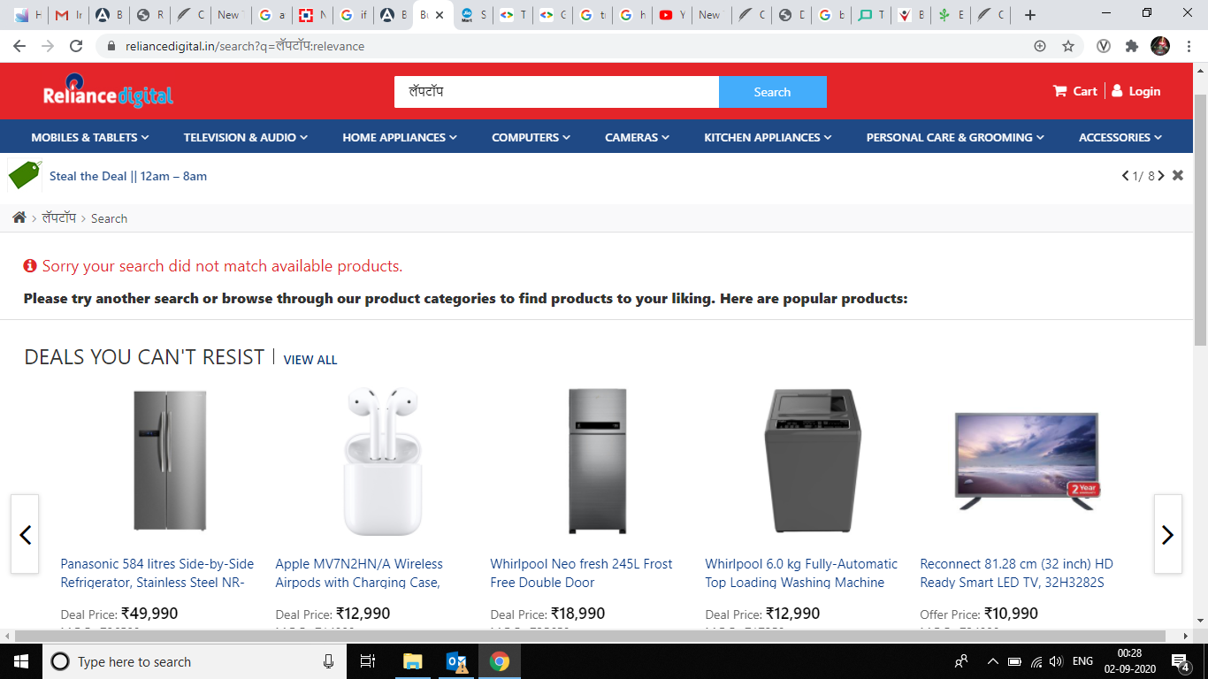
Product Catalogue Tagging: Why Tagging?

Slide 4
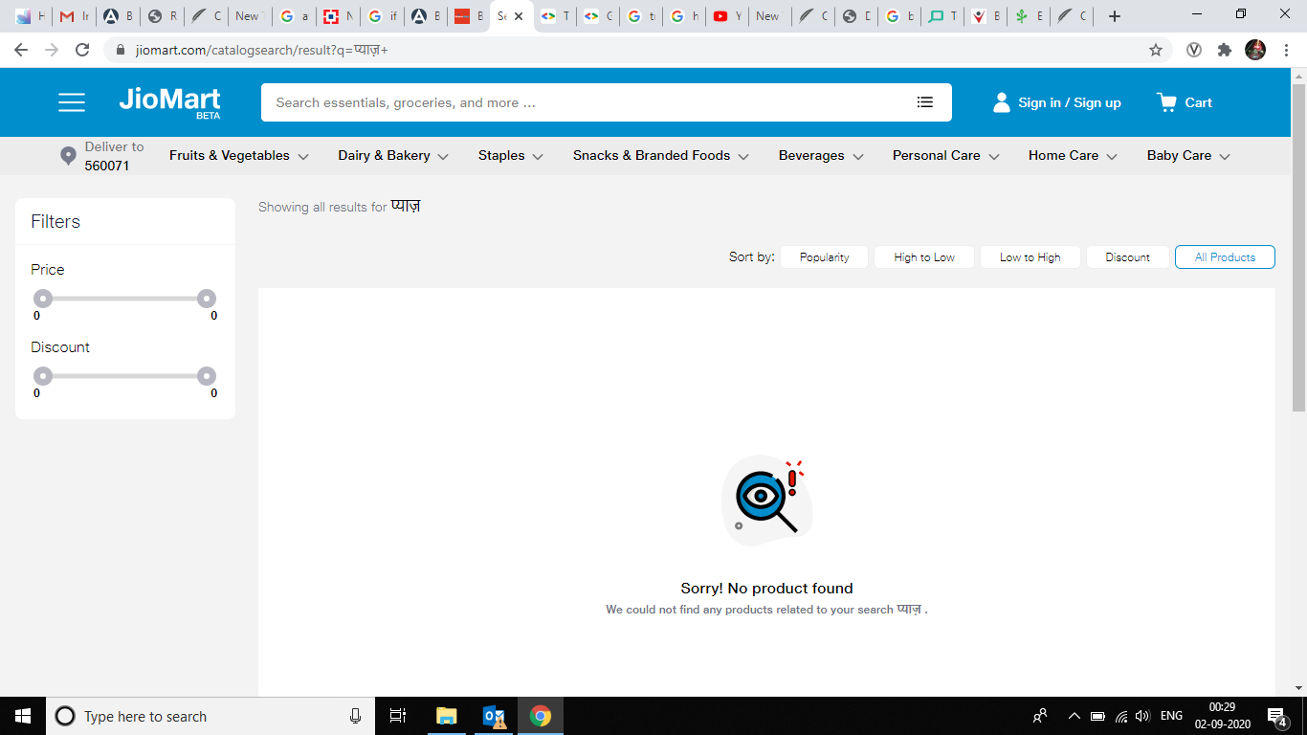
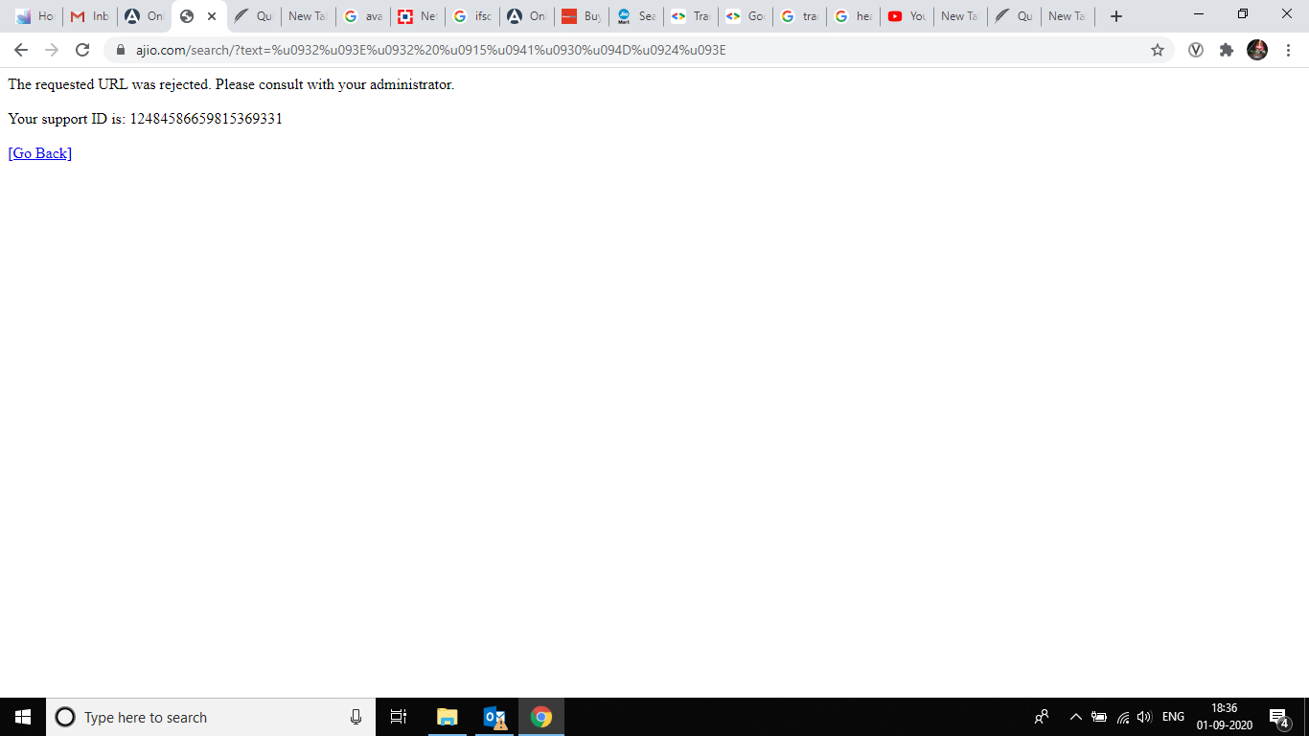
Product Catalogue Tagging: Why Tagging?
Query on Jiomart: प्याज़
Query on AJIO : लाल कुरती

Slide 5
Product Catalogue Tagging: Why Tagging?
JioMART non-English query statistics
Query | Count
बेसन | 60
राइस | 60
साफ | 62
अमूल | 63
सौ | 71
पातंजल | 71
पाटन | 86
Query | Count
घी | 93
शुगर | 96
री | 750
सोए | 47
पतंग | 51
पर्ल | 88
राव | 213
Query | Count
जग | 120
पोहा | 163
काजू | 58
चॉकलेट | 45
माघ | 150
आम | 78
సు | 41
Query | Count | Conversion | Click Count
potato | 4334 | 406 | 923
Comparison of Aloo and Potato
aloo | 5048 | 168 | 497

Slide 6
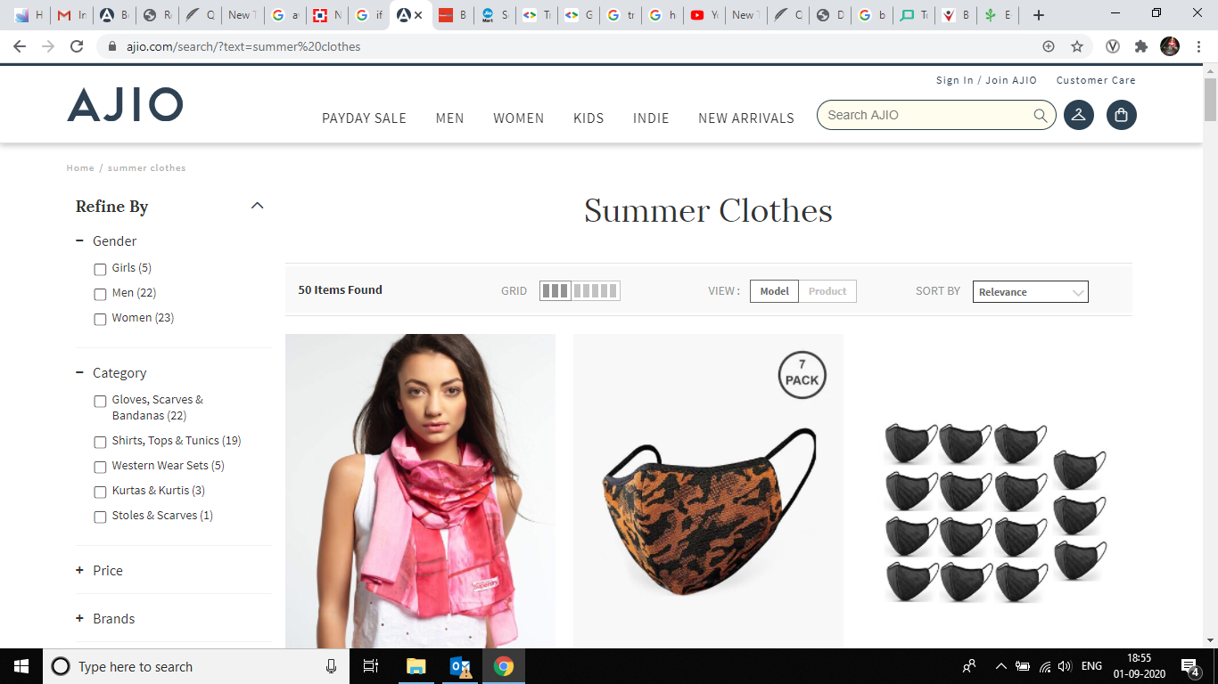
Product Catalogue Tagging: Why Tagging?
Irrelevant results for queries on AJIO
query: Summer Clothes

Slide 7
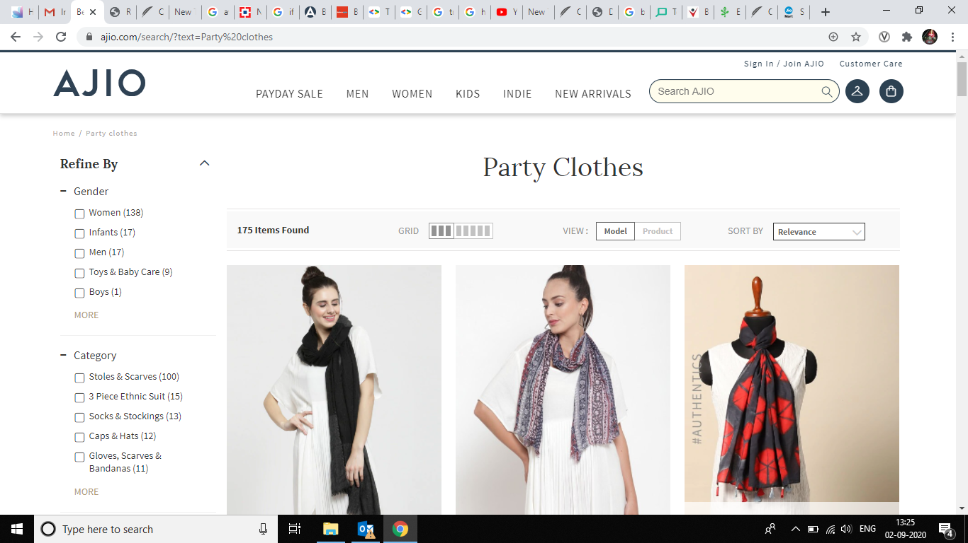
Product Catalogue Tagging: Why Tagging?
Irrelevant results for queries on AJIO
query: Party Clothes

Slide 8
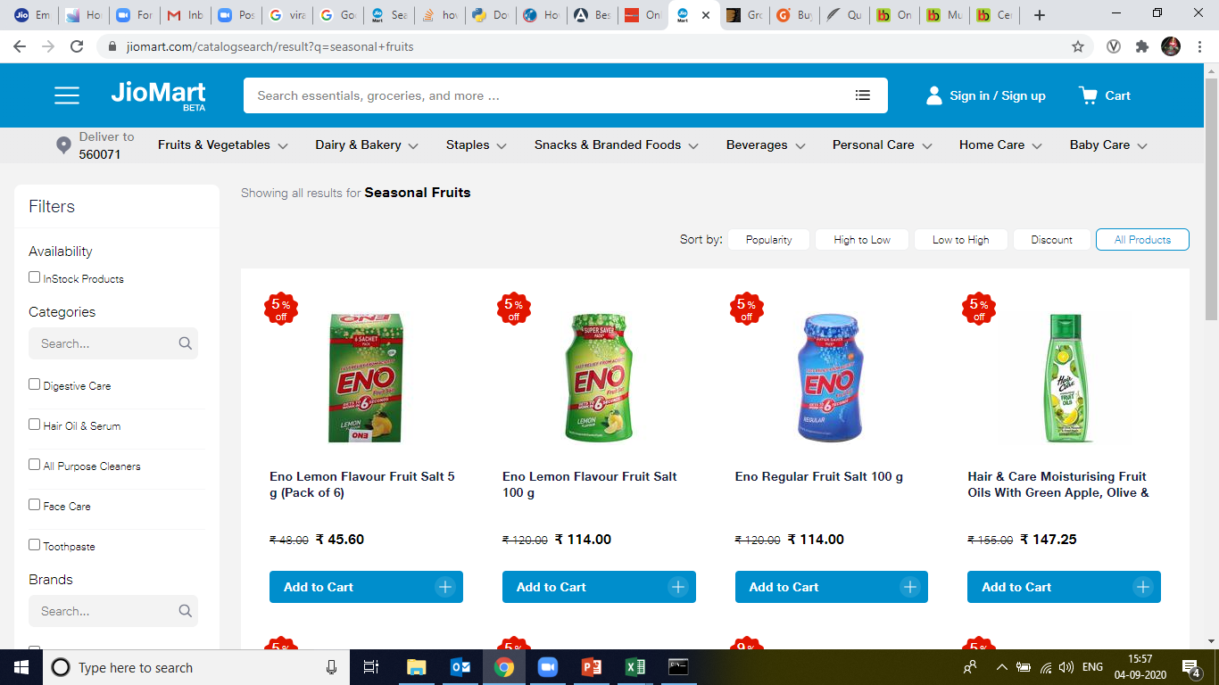
Product Catalogue Tagging: Why Tagging?
Irrelevant results for queries on Jiomart
query: Seasional Fruits

Slide 9
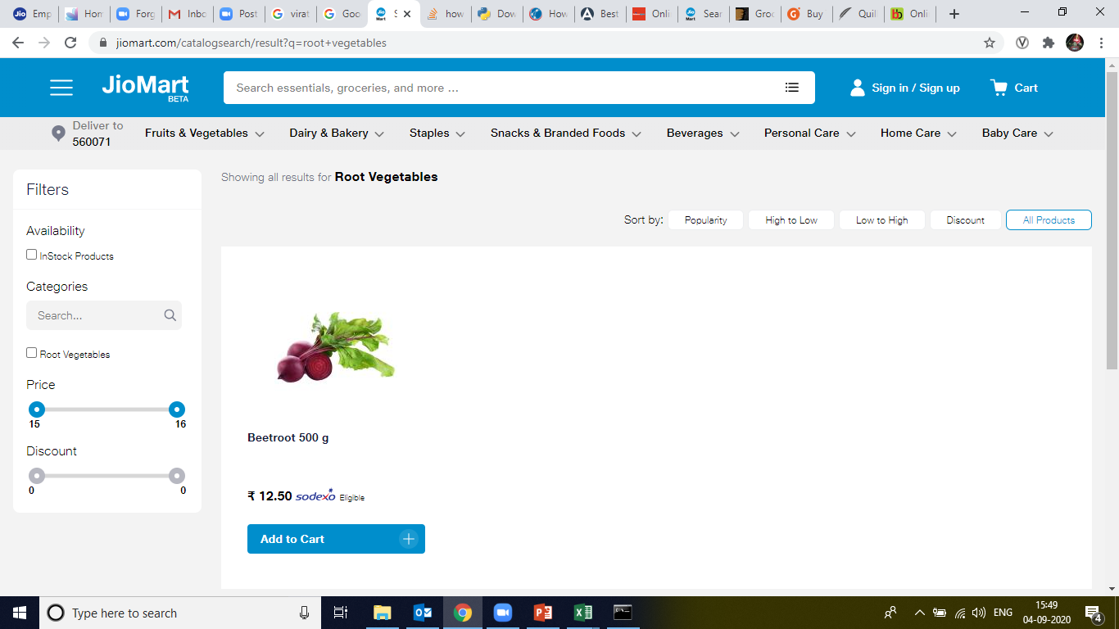
Product Catalogue Tagging: Why Tagging?
Irrelevant results for queries on Jiomart
query: Root Vegetables

Slide 10
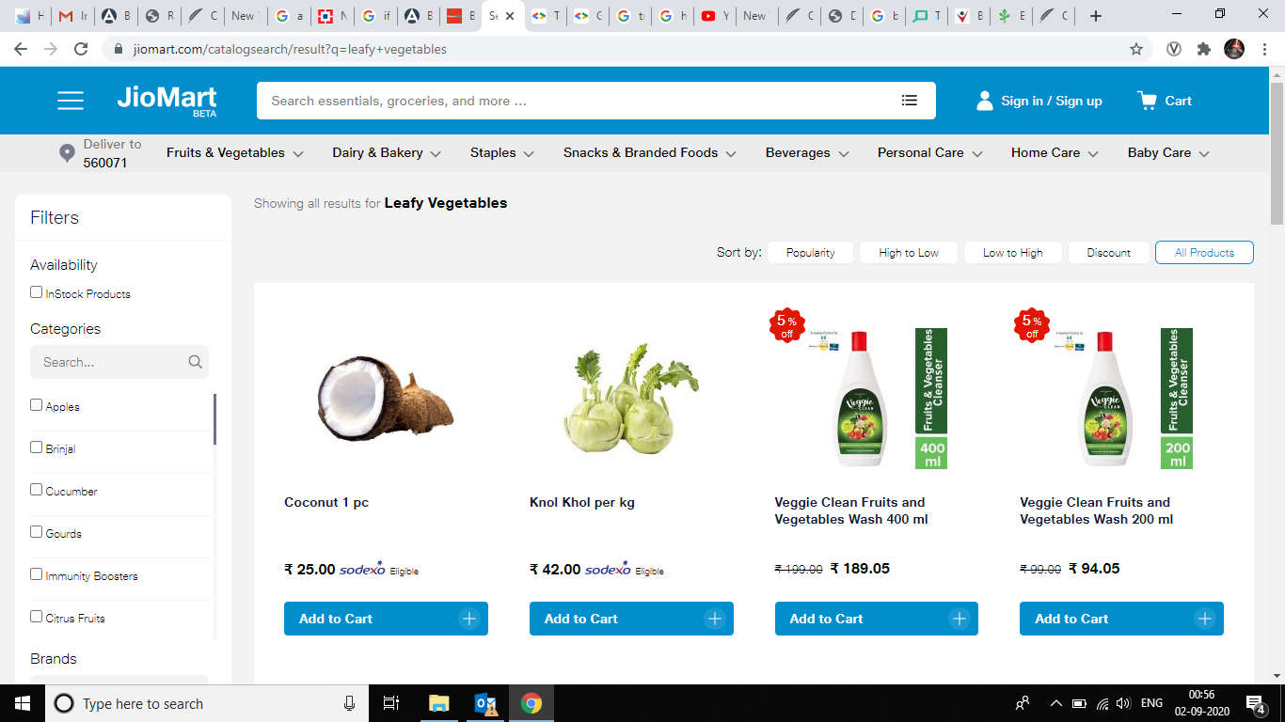
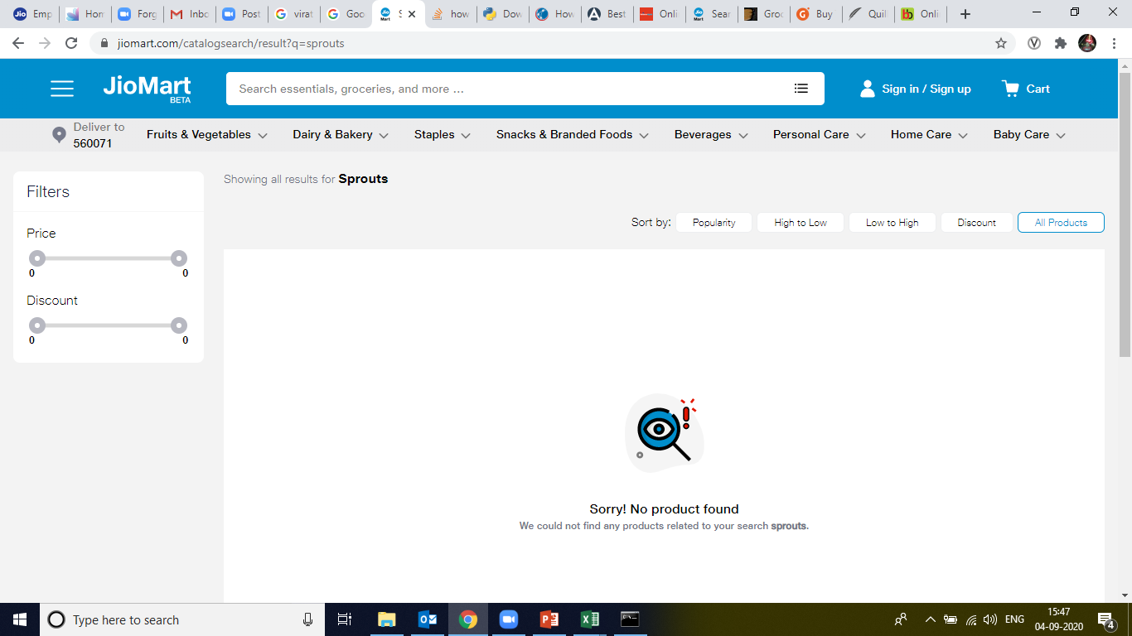
Product Catalogue Tagging: Why Tagging?
Irrelevant /No results for queries on Jiomart
query: Leafy Vegetables
query: Sprouts

Slide 11
Product Catalogue Tagging: Why Tagging?
Couple of interesting statistics of Jiomart search queries data
Query | Count | Click Count | Conversion
Sprouts | 148 | 1 | 0
Leafy Vegetables | 601 | 36 | 3
Query count proves the possible existence of thematic queries.
CTR and conversion rate for these thematic queries proves irrelevancy of result.

Slide 12
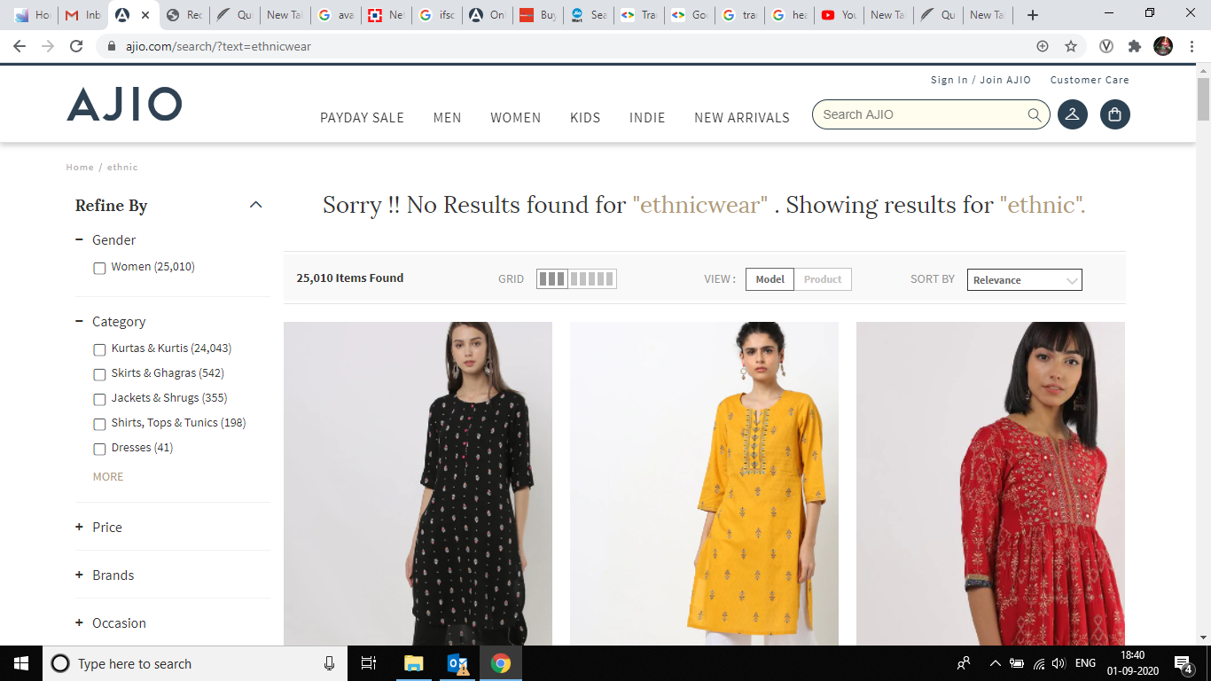
Product Catalogue Tagging: Why Tagging?

Slide 13
Product Catalogue Tagging: Why Tagging?

Slide 14
Catalog Indexer as a solution
Solutions

Slide 15
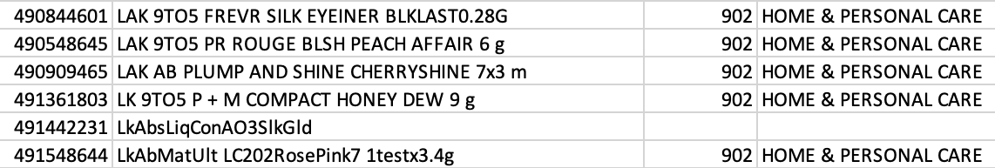
Text Preprocessor: Fixing Spell Check/Word Break
Query Logs
model training
Fortune haelthy low cholesterol oil1kg
Text Processor
Fortune healthy low cholesterol oil 1kg
raw catalog attribute(title)
processed catalog attribute(title)
Sample Jio Mart Catalog
A lot of products have such spelling or word break issues, which hampers product visibility

Slide 16
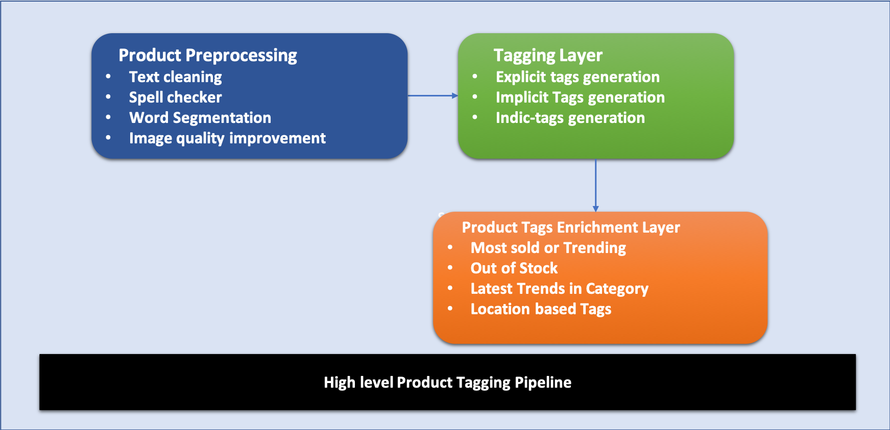
Product Tagging: High Level Product Tagging Pipeline

Slide 17
Product Tagging: Fixing Missing Attributes Issue
Attribute Prediction Models
Parent(L1), Child Category(L2) and other relevant attributes
Product Description
Entity Recognition Model
Tertiary Category(New L3)
Aim is the automatic tagging of different categories levels and other such attributes given product a description.
A product without tagged attributes have a very limited visibility in search space therefore we loose in revenue which can be easily avoided using automatic product tagging.

Slide 18
Product Catalogue Tagging: Adding relevant attributes
Current Inventory Stock Data
Last Month Sale Data
User Clickstream data
Implicit Tags using Topic Modelling and Clustering
Implicit Tag Generator Model
Tags Enrichment Module
Image Tags using object and other feature detection
Product Catalogue DB with all details
Id
Text tags using Automatic Keyword Extraction
Products with all possible relevant tags
Translated and transliterated tags generator
Preprocessing
L1,L2 and L3 category prediction model

Slide 19

Product Catalogue Tagging : Example
1234
Product Catalogue DB with all details
Shirt, Black, Partywear, Lee, Chinese Collar, full sleeve
Id
Image Tags using object and other feature detection
Shirt, Lee, Black, Plain Black Shirt
Text tags using Automatic Keyword Extraction
Desc: Lee plain black shirt
Image
Preprocessing
Products with all possible relevant tags
Lee PlainBlack Shirt
Translated and transliterated tags generator
Kurta, Kala Kurta, काला कुरता , कुरता
L1,L2 and L3 category prediction model
Topwear, Casual Shirt , Plain black shirt

Slide 20
Product Catalogue Tagging: Indic Tags
Indic-Tags are needed to make them searchable even in case of Indian search queries.
Below is an example of possible Indic-tags for ”Potato”
Potato : [Aloo, Batata, Uralaikilangu, Urlagadda, Kook , Kizhangu]
Potato: [आलू, અલૂ, बटाटा, ಆಲೂಗಡ್ಡೆ, ಉರಾಲೈಕಿಲಂಗು]

Slide 21
Product Catalogue Tagging: Enrichment Tags
Enrichment tags can help in increase of sale from customer point of view psychologically.
”Depleting Fast” tag can help to make user do the transaction as soon as possible.
These tags also provide some extra details about the product like “current trends”/ ”latest fashion” or “out of stock”/ “broken style”.

